Slide 1
DVC – Version Control System for Machine Learning Projects
Cologne, 8.10.2019, Marcel Fernandez Rosas, Daniel Schulz

Slide 2

SEC2
Git-compatible
Metric tracking
Linking of branches or tags with custom metric values
Progress-tracking of all branches with a single command
Compatible with any standard Git server
Offers all advantages of a distributed version controll system
Storage agnostic
ML Pipeline framework
Choose between different could providers to store the data
Or choose very own storage solution
Connect ML-steps to an end-to-end ML pipeline
Caches intermediate results
Reproducible
Language and framework agnostic
End-to-end reproducibility with a single command
Consistent maintenance of data, configurations and code
Support of any programming language, library and code structure

Slide 3
DVC – Open Source Version Control System for Machine Learning Projects
SEC2
Why is DVC useful in development?
The concept of DVC
Automize workflows with ML-Pipelines
Examples
Summary

Slide 4

Storing Large Files in a Code Repository Leads to Bad Performance
SEC2
Git is Used to Store Small Data Files Like Code
To keep track of different versions of developed code, a version control system is crucial
Git as version control system is widely used in software development
AI algorithms need large data files for training and testing
Storing large data files in Git slows down the performance
Bad performance of git slows down the work of a developer
Notes:
Git came up around 15 years ago

Slide 5

Keeping Track of Data Files in the Same Way Like Code
SEC2
DVC let’s us Separate the Data Files from the Code
DVC follows the same principle like git and has an integration with git
Developers can apply the same workflow for code to data as well
Selection of own storage location, we picked an Amazon S3
Independent of different storage providers
DVC is language- and framework agnostic

Slide 6
DVC – Open Source Version Control System for Machine Learning Projects
SEC2
Why is DVC useful in development?
The concept of DVC
Automize workflows with ML-Pipelines
Examples
Summary

Slide 7





Separation of Code and Data Leads to Better Performance
SEC2
Working with Large Data Files is much Faster with DVC
Push and pull code
Push and pull data

Slide 8
DVC – Open Source Version Control System for Machine Learning Projects
SEC2
Why is DVC useful in development?
The concept of DVC
Automize workflows with ML-Pipelines
Examples
Summary

Slide 9

DVC Lightens the whole AI Workflow
SEC2
Machine Learning Pipelines and Experiment Management reduces Rework
Every building block for a successful AI model is storable
Concatenation to a machine learning pipeline automates manual tasks
Easy reproduction of building blocks or whole pipelines
Automatic metric tracking for a better structure of different ideas
Easy failure tracking and information sharing

Slide 10

Our Machine Learning Pipeline includes widely used Techniques and Best Practices
SEC2
Dataset
loading
Feature Engineering
Data Preparation
Model Training
Evaluation & Reporting
Data Profiling
The DVC Pipeline we implemented shows Multiple Steps

Slide 11
DVC – Open Source Version Control System for Machine Learning Projects
SEC2
Why is DVC useful in development?
The concept of DVC
Automize workflows with ML-Pipelines
Examples
Summary

Slide 12

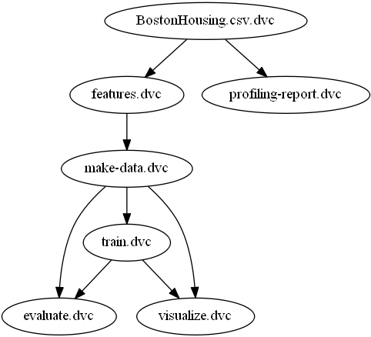
Examples – Pipeline Visualization
SEC2
With the command ‚dvc pipeline show -–dot‘ we get the built
pipeline in .dot format which we can vizualize with GraphViz.

Slide 13
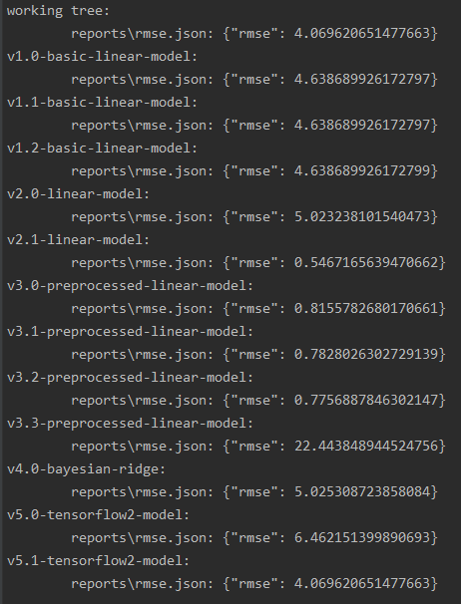
Examples – Metric tracking
SEC2
With the command ‚dvc metrics show -T‘ we get the all metric values
for all tags we have in the repository.

Slide 14
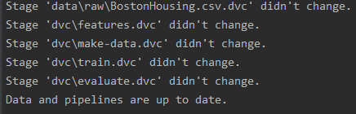
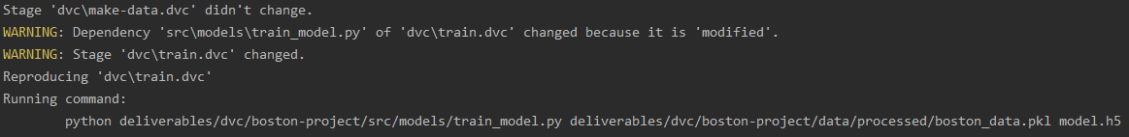
Examples – Reproducible Pipeline
SEC2
With the command ‚dvc repro evaluate.dvc‘ we can start reproducing
the pipeline from the evaluate step backwards.
If we change nothing we see the following:
If we change something in the training step, dvc will recognize it and
run the affected pipeline stages again:

Slide 15
DVC – Open Source Version Control System for Machine Learning Projects
SEC2
Why is DVC useful in development?
The concept of DVC
Automize workflows with ML-Pipelines
Examples
Summary

Slide 16
SEC2

Slide 17
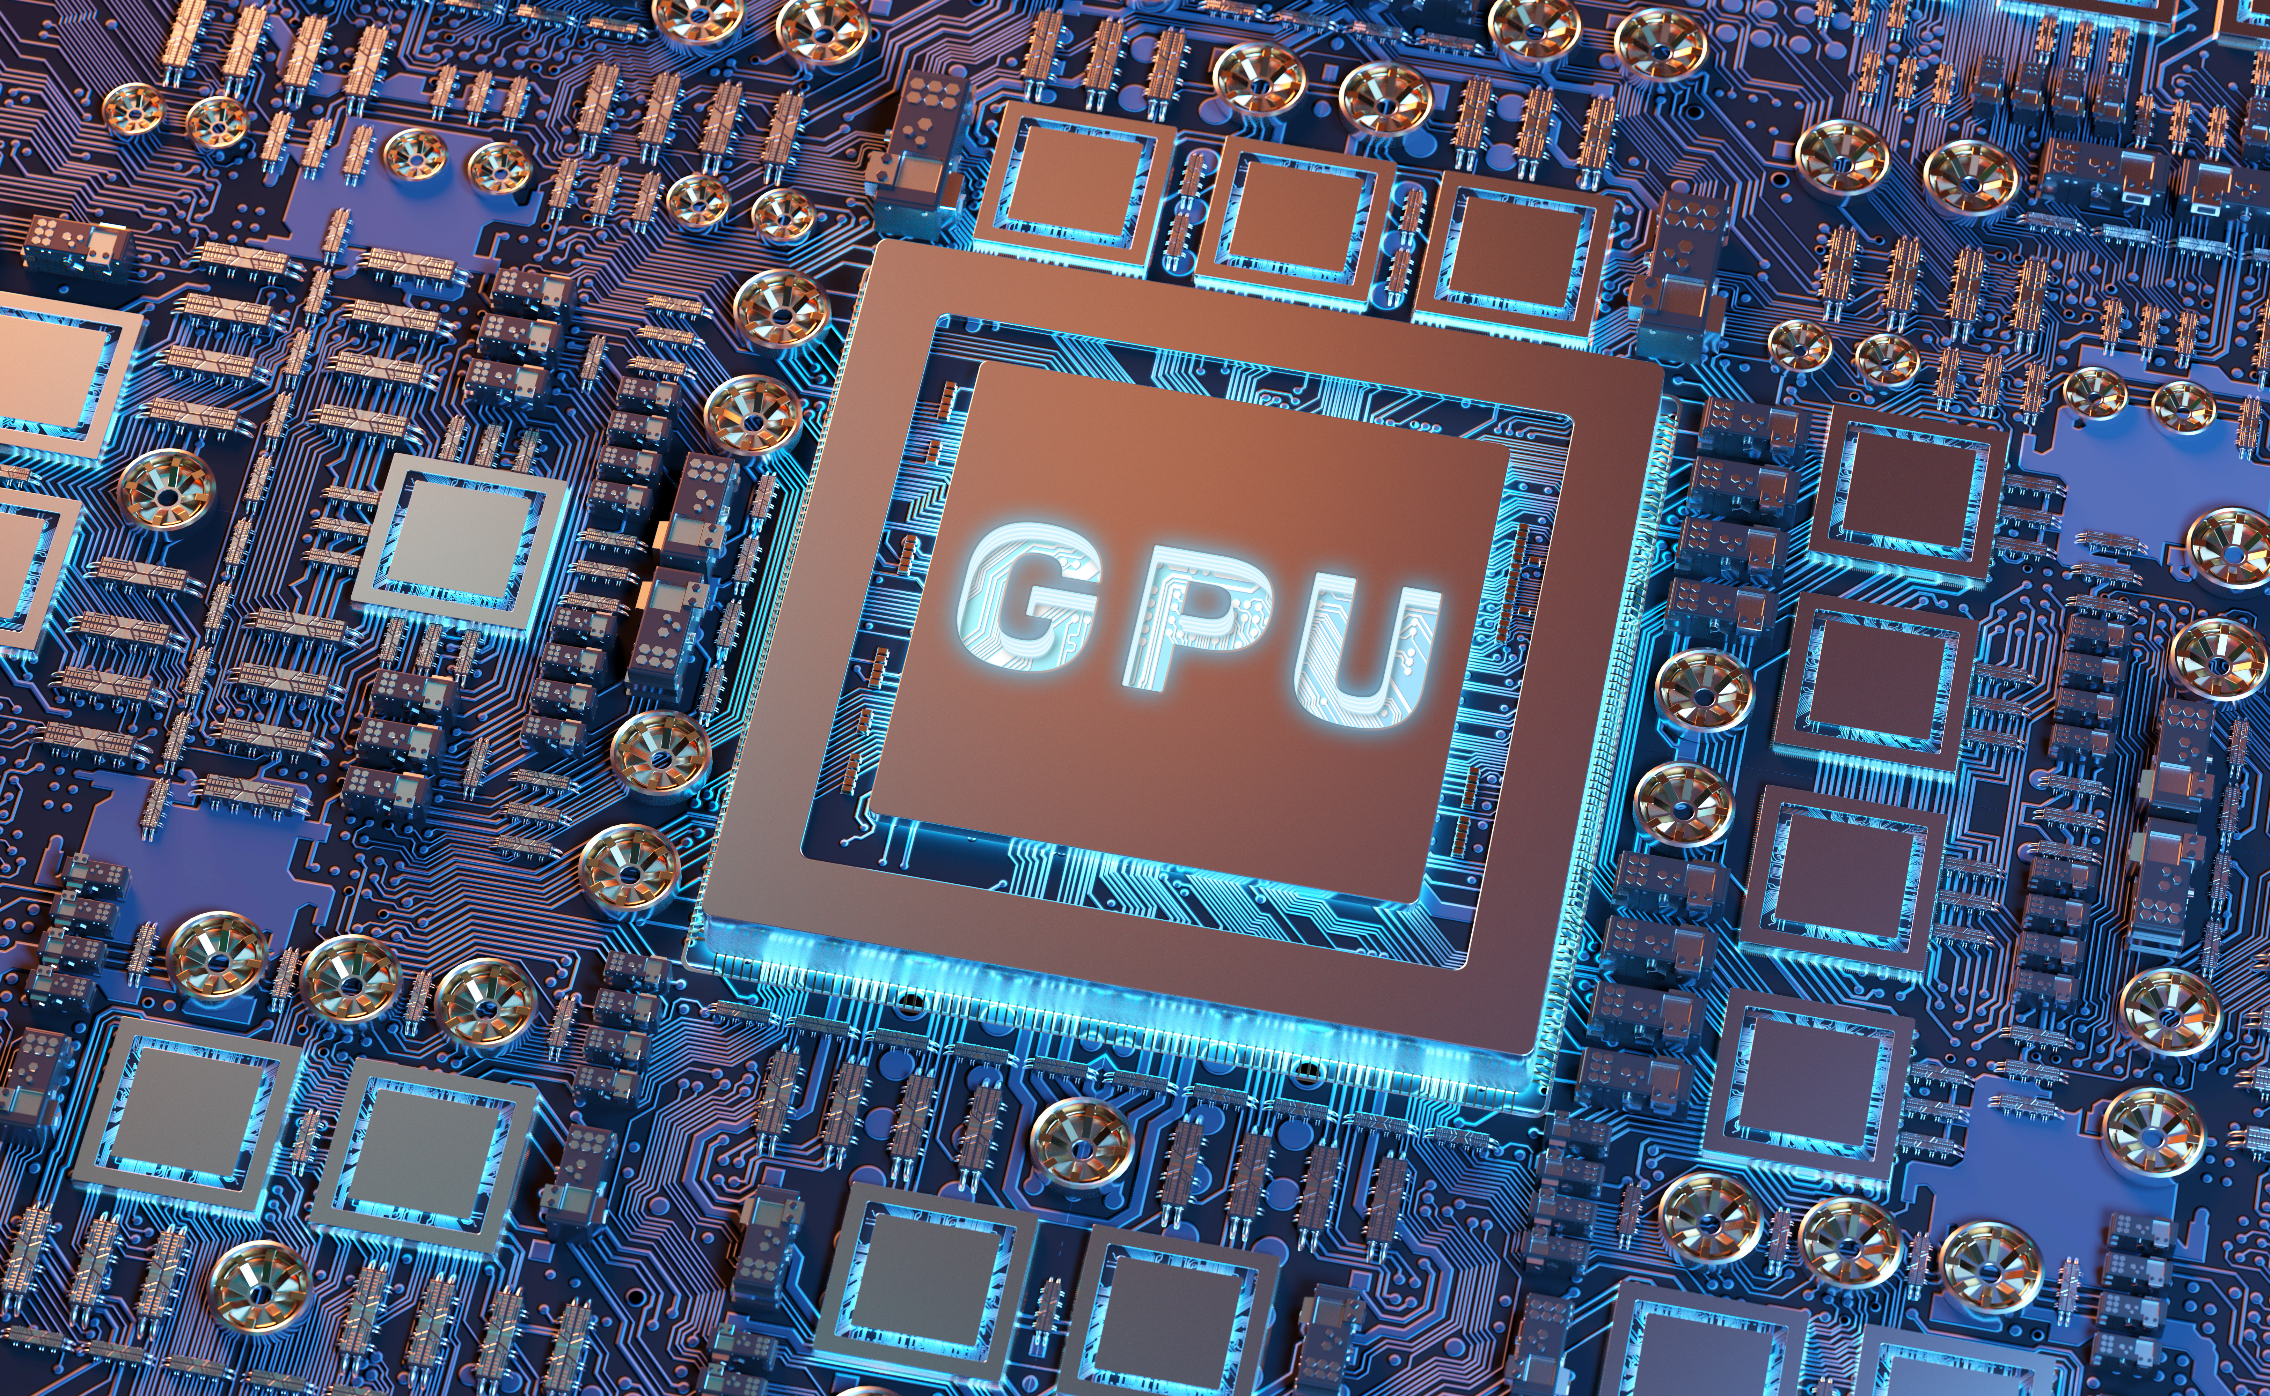
Automated Model Training with the Power of GPU
The Pipeline simplifies the Management of trained Machine Learning Models

